Slide 1
Building APIs With ASP.NET Web API 2
Jamie Ide
July 13, 2015

Slide 2
I am not an expert
Microsoft: Learning and documentation http://chimera.labs.oreilly.com/books/1234000001708
O’Reilly: Designing Evolvable Web APIs with ASP.NET http://chimera.labs.oreilly.com/books/1234000001708
Apigee: Web API Design https://pages.apigee.com/rs/apigee/images/api-design-ebook-2012-03.pdf
The usual suspects: Pluralsight, Stackoverflow

Slide 3
Goals
Web architecture
Design
Versioning
Securing
Testing
Consuming

Slide 4
Web architecture
HTTP HyperText Transfer Protocol
HTTP/1.1 - RFC 7235 https://tools.ietf.org/html/rfc7235
HTTP/2 RFC 7540 https://tools.ietf.org/html/rfc7540
Request
URI – Uniform Resource Identifier
Method (verb) – GET, POST etc.
Headers – User-Agent, Accept etc.
Body
Response
Status code – 200 (OK) etc.
Headers – Content-Type etc.
Body

Slide 5
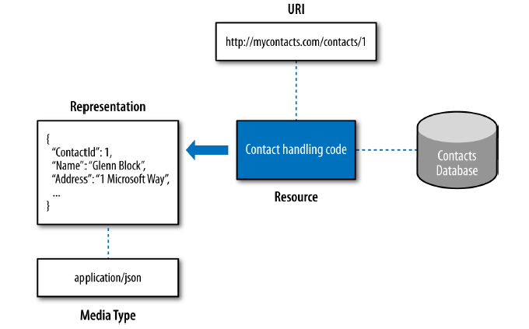
Web architecture
Source: Designing Evolvable Web APIs with ASP.NET, O’Reilly

Slide 6
Application Program Interface
Exposing resources using HTTP communication
Uniform interface for accessing entities
Stateless
REST – Representational State Transfer
A style, not a framework or specification

Slide 7
CRUD
Operation | Request Method | Response Status Code
Create | POST | 201 Created
Read | GET | 200 OK
Update | PUT | 200 OK
Delete | DELETE | 200 OK
Create example:
Request
URI: POST stacksofwax.com/api/artists
Body: { Name = “The Rolling Stones” }
Headers: Content-Type: application/json
Response
Status code: 201 Created
Headers: Content-Type: application/json
Location: stacksofwax.com/artists/123
Body: { ArtistId = 123,
Name = “The Rolling Stones” }

Slide 8
Microsoft ASP.NET Web API 2
First class HTTP programming model
Support for multiple formats (JSON, XML etc.) and content negotiation
Follows conventions
Rich routing
Testable

Slide 9
Routing
Same as MVC
Attribute Routing
RoutePrefix on class – [RoutePrefix(“api/artists”)]
Route on action – [Route(“{id}/albums”)]
config.MapHttpAttributeRoutes();

Slide 10
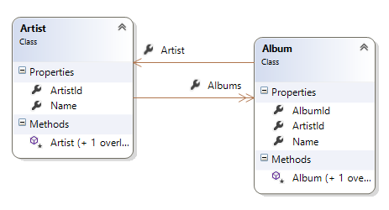
Demo Introducing Stacks of Wax Scaffolding
Stacks of Wax is a simple music catalog
Two classes, Artist and Album, with a one-to-many relationship
Uses Entity Framework for data access
/1 Shared
StacksOfWax.Models
StacksOfWax.DataAccess
StacksOfWax.DataAccess.Tests
Database Initializer extends DropCreateDatabaseAlways
Uses mssqllocaldb - SQL Server 2014 default instance (localdb)\MSSQLLocalDB
Github: https://github.com/jamieide/StacksOfWax

Slide 11
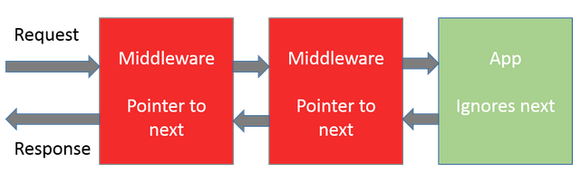
OWIN Katana
Open Web Interface for .NET
Specification for interface between .NET server and application
Katana is Microsoft’s OWIN implementation
Tighter integration in vNext (ASP.NET 5)
Decouples server and host
Reduces dependency on IIS/System.Web
Pipeline with middleware
Self-hosting
Source: http://stackoverflow.com/a/21308836/12752

Slide 12
Demo
OWIN & Katana Samples http://www.asp.net/aspnet/samples/owin-katana
Visual Studio 2013
File > New Project
ASP.NET Web Application
Empty template
PM> install-package microsoft.owin.host.systemweb
PM> install-package microsoft.owin.diagnostics
PM> intall-package microsoft.aspnet.owinselfhost
Right-click project, Add > OWIN Startup class
app.UseWelcomePage();
app.Run(context => { context.Response.ContentType = "text/plain“; return context.Response.WriteAsync("Hello world!"); });
Comment out global.asax.cs
Testing
Self-hosting and in-memory hosting

Slide 13
Versioning
Style | Example | Remark
URL | api/v2/artists api/artists/v2 | Easy to consume & test Resource location changes
Querystring | api/artists?v=2 | Easy to consume & test
Custom header | x-api-version: 2 | Harder to consume & test
Accept header | application/vnd.artist.v2+json Application/vnd.artist;v=2 | For the REST purist
Your API versioning is wrong, which is why I decided to do it 3 different wrong ways
Is versioning part of your domain (e.g. document control)?
Who are your users and how easy do you want to make it for them to consume your API?
Are you a purist?

Slide 14
Demo
Uses route versioning
Route template is api/v{version}/{controller}/{id}
Controller naming convention
ArtistsV1, ArtistsV2
ArtistV2 model includes album count
IHttpControllerSelector implementation selects controller from version in route

Slide 15
Security
Basic Authentication over HTTPS
Username and password are passed in every request
Must use HTTPS
HMAC – Keyed Hash Message Authentication Code
Secret key and has algorithm are known to API and application
Hash is sent in header
Can guard against replay attacks
OAuth 2
Requires token server
Token is sent in request

Slide 16
Demo
Basic Authorization
Authorization header missing
Server responds with challenge
Authorization header present
Server authenticates
HMAC Authorization
Same flow but custom header authentication scheme

Slide 17
Demo Sample Application
StacksOfWax sample application
Separate API and Web projects, both must be started
Odata filter

Slide 18
Omissions Questions
CORS – Cross Origin Resource Sharing
PM> Install-Package Microsoft.AspNet.WebApi.Cors

